Slide 1
Analyzing Amazon Sales Data for Sales Trend Analysis in E-commerce
Name- Vivek Satendra Prasad
Roll no- RMB22MB037
Guide- Prof. Pramila Pareekh

Slide 2
Content
Introduction
Objective
Scope
Theoretical Background
Research Methodology
Data Transformation and EDA

Slide 3
Introduction
The e-commerce industry is witnessing unprecedented growth, and Amazon stands as one of the leading players in the market. Effective sales management and data analysis are crucial to understand and optimize sales trends. This project aims to analyze Amazon sales data to uncover sales trends and key factors contributing to those trends. We will employ various data analysis techniques, including ETL (Extract-Transform-Load), Python, and Power BI, to gain insights into the sales performance of Amazon.

Slide 4
Objectives
To analyze Amazon sales data to identify sales trends on a monthly, yearly, and yearly-month basis.
To discover key metrics and factors influencing these sales trends.
To establish meaningful relationships between attributes to better understand the dynamics of Amazon sales.

Slide 5
Scope
Analyzing sales data from Amazon for a specific period.
Examining sales trends on a monthly, yearly, and yearly-month basis.
Identifying key metrics and factors affecting sales trends.
Creating visualizations to represent the findings effectively.

Slide 6
Theoretical background
Sales management in the e-commerce domain is crucial for understanding customer behaviors, product demand, and market fluctuations. In this project, we will apply principles of business intelligence and data analysis to interpret Amazon sales data. ETL processes will be employed to extract, transform, and load the data for analysis. Theoretical concepts related to data analysis, including statistical analysis, time series analysis, and correlation analysis, will be utilized to gain insights into sales trends.

Slide 7
Research methodology
Data Collection
ETL Process
Exploratory Data Analysis(EDA)
Sales Trend Analysis
Key Metrics Identification
Visualization
Findings and Recommendations
Conclusion

Slide 8
About the data
The dataset is about the sales of electronic products from amazon platform in year 2019. Data is divided into 12 csv files and each file holds data for one month. The final dataset has following attributes :
Order ID : Unique Order ID number per Order
Product : Name of ordered Product
Quantity Ordered : Number of Items Ordered
Price Each : Price of one item (in $)
Order Date : Date when order was placed
City : City from where order was placed
State : State from where order was placed
Category : Category of the ordered Product

Slide 9
Data Transformation and EDA
Handling Null values :
There are some rows which are having only null values, so dropping those rows from the dataset.
Deriving Columns :
City and State columns were derived from Purchase Address column.
Category column was created based on the name of the Product in Product Column

Slide 10
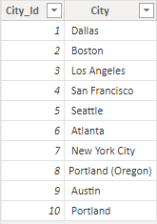
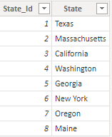
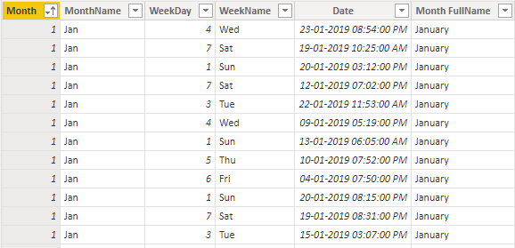
3. Removing Unnecessary Columns :
After extracting City and State columns from Purchase Address Column, dropping the column from the dataset.
Creating Tables using M Language :
We have to create Cities, States and Dates Tables using Column from dataset for data modelling.
Cities Table
States Table
Dates Table

Slide 11
Thank You
Presentation By : Vivek Prasad

